Slide 1
Low-carb diets in the management of obesity
YoonJu Song
The Catholic University of Korea
Notes:
Session: Diet and Metabolism (25 min presentation,
14:00-14:30 Calorie Restriction on Metabolism and Aging (Leonie Heilbronn, Australia)
14:30-15:00 Obesity and Trans Fatty Acid (Geeta Appannah, Malaysia)
15:00-15:30 Low-carbohydrate diets in the management of obesity (YoonJu Song, Korea)

Slide 2
Contents
What are Low-Carb Diets?
Effects on Cardiometabolic Risk Factors
Carbohydrate Intake in Korea
Beyond Low-Carb Diets: Healthy Low-Carb Approaches
Summary
Notes:
Let me briefly introduce what we’ll cover today. First, we’ll define what low-carb diets are and explore the recent evidence on their effects on cardiometabolic risk factors. Then, we’ll take a closer look at carb intake in the Korean population, followed by a discussion on how to approach healthy low-carb diets. Finally, we’ll summarize the key points.

Slide 3
What are low-carb diets??
★ History
1860s – a strategy for weight loss
early 1970 – public interest
many commercial low-carb diets
Atkins, Zone, Paleolithic
(% of energy)
 | Carb | Protein | Fat | SFA | Non-SFA
Akins diet | 5 | 36 | 59 | (23 | 36)
Zone diet | 40 | 30 | 30 | (10 | 20)
Willett | 45 | 15 | 40 | (10 | 30)
AHA 2000 | 55 | 15 | 30 | (10 | 20)
(Astrup et al, Lancet 2014)
Notes:
What are low-carb diets? Why does it matter? It matters to me because after examining Korean dietary data from the past decade, I’ve been curious about what the “right” number of carb intake should be, especially given Korea’s high-carb dietary culture. About 20 years before, Korean adults consumed more than 65%, almost close to 70%. While much of the literatures suggests 20 to 40%, I wonder how realistic that is for Korea.
Let me briefly touch on the history of low-carb diets. LCDs became popular in the 1860s, thanks to William Banting who claimed to have lost 21 kg without hunger. Since then, many variations of LCD have emerged. One of the most famous is the Atkins diet, which you’ve likely heard of- it’s been one of the most successful low-carb approaches over the years.
However, many variations of low-carb diets have lead to no universal definition. The graph in the middle of this slide shows one literature to categorize different LCDs, including the Akins diet. To make it easier to understand, I’ve created a table next to the graph. You can clearly see how carb intake differs across various types of LCDs.

Slide 4
Low-carb and very-low-carb diets
A scientific statement from the National Lipid Association Nutrition and Lifestyle Task force
 | Carb
Very-low carb | <10%
Low carb | 10-25%
Moderate carb | 26-44%
High carb | 45-65%
Very-high carb | >65%
(Kirkpatrick et al, J Clin Lipidol 2019)
Notes:
Here is another literature to categorize different LCDs, this one suggested by the US National Lipid Association. I’ve also created a table to show carb intake by different definitions. This classification is more refined, with very-low carb defined as less than 10% of energy, while low-carb diets are defined as only 10-25%, which feels quite strict compared to other approaches. Additionally high carb diets are defined as more than 45%, which also feels quite strict compared to what we typically see in the Korean diet. This classification really highlights how different the standards can be depending on the context.

Slide 5
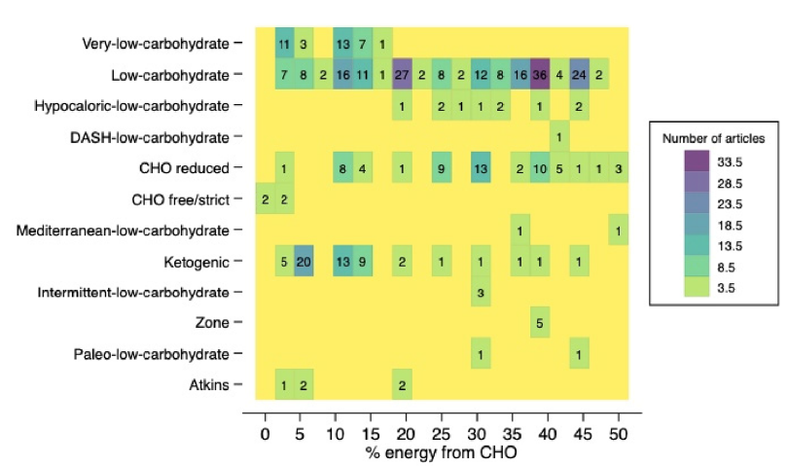
Defining “low-carb” in the scientific literatures
Literature published from Jan 2002 to June 2022 using 3 database,
n=508 articles (317 RCT, 99 cross-over, 33 before-and-after, 59 other clinical trials)
(Chacon et al, Crit Rev Food Sci Nutr 2024)
Various types of low-carb diets
Could be different metabolic effect due to range of carb intake, protein & fat amount or source
※ Very-low carb < 10% (5-15%)
(ketogenic)
Low-carb diets < 45 (50%)
Notes:
This is the recent article scoping the definition of LCDs in the science literatures published from 2002 to 2022. Based on 508 articles, the authors found that varying definition can lead to different metabolic effect. This is due to not only the range of carb intake but also the amount and source of protein and fat intake.
As shown in the heat map on the right, various types of LCDs exists, such as Carb-restricted, low-carb with high fat, low-carb with high protein, with carb intake ranging from 0% to 50% of energy. In general, we can differentiate into low-carb diets and very-low carb diets: low-carb diets are a broader category, defined as having less than 45% of energy, while very low-carb diets, often referred to as ketogenic diets, are more restrictive, comprising less than10%.
*Most studies (51.9%) simply referred to as “low-carb diets”.

Slide 6
Low-carb vs Low-fat diet
Low-carb
(high-fat)
diet
Carbohydrate intake
Very-low | 20-50g (5~15%)
Low | < 45%
Balanced | 45-65%
High | >65%
Low-fat
(high-carb)
diet
Fat intake
Low | <25%
Balanced | 25-35%
High | >35%
Effective for weight loss in the short term
Increase energy expenditure
Suppress hunger to a greater degree
However, long-term effects have not been fully established
Cause ketogenic diet
Increase high-saturated fat intake & serum LDL-cholesterol level
High protein intake may lead to acid load
Effective for weight loss!
However, lack of satiety cause to decrease adherence over longer periods
Higher GI meal, higher insulinemic response
Increase hunger & lower satiety
(Libeman, Nutrition 2014; Naude et al, PLoS One 2014)
Notes:
Although there is no universal consensus on the effects of low-carb diets, several meta-analysis allow us to summarize the findings to date. It is important to emphasize that both diets can be effective for weight loss, albeit for different reasons.
Low-carb diets are typically classified as less than 45%, with very-low carb diets ranging 5% to 15%. Despite being accompanied by higher fat intakes, low carb diets demonstrate noticeable and immediate effects on weight loss. In the initial phase, these diets can increase energy expenditure and suppresses hunger. However, the long-term effects remains less well established.
Conversely, low-fat diets are defined as having less than 25% or 30% of energy. While these diets can also lead to weight loss, they often result in lower satiety, which can increase feelings of hunger and decrease adherence to the diet.

Slide 7
Carbohydrate intake & Cardiometabolic risk factors
Notes:
Let’s move to the recent evidence between carb intake and cardiometabolic risk factors.

Slide 8
Low-carb vs Low-fat diets: weight loss
Meta-analysis
Period: up to Sep 2019
Studies: 38 RCTs of 6,499 adults
Definition
Low-carb < 40%
Low-fat < 30%
(Chawla et al, Nutrients 2020)
Notes:
This slide presents recent evidence on the effects of low-carb diets. This meta-analysis included 38 RCTs involving 6,499 participants. The overall mean difference in weight loss favored the low-carb diets, showing a reduction of -1 kg. However, when analyzed by study duration, significant results for low carb-diets were observed only at 6 to 12 months, with no significant differences noted in other time periods.

Slide 9
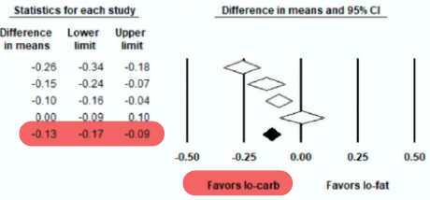
Low-carb vs Low-fat diets: blood lipids
Meta-analysis
Period: up to Sep 2019
Studies: 38 RCTs of 6499 adults
Definition
Low-carb < 40%
Low-fat < 30%
Low fat diets: LDL & total cholesterol
Low carb diets: TG HDL
(Chawla et al, Nutrients 2020)
Notes:
This study showed additional parameters. For LDL-cholesterol, low-fat diets were favored, showing a decrease 0.11 mg/dL. In contrast, low-carb diets showed a more significant benefit for serum triglycerides, with a decrease of 0.13 mg/dL. Overall, low-carb diets proved more beneficial than low-fat diets for weight loss, HDL cholesterol, and triglycerides in the short-term, while low-fat diets were more beneficial for LDL and total cholesterol. These findings suggest that dietary approaches should be tailored according to participants’ baseline levels.

Slide 10
Low-carb vs Low-fat diets: weight reduction
Long-term
Weight reduction
6-11 months
-2.10 (-3.07 to -1.14)
12-23 months
-1.21 (-1.79 to -0.63)
24 months
-0.59 (-1.82 to 0.63)
Overall
-1.33 (-1.79 to -0.87)
Meta-analysis
Period: up to Mar 2022
Studies: 33 trials with ≥ 6 months, 3,939 adults with overweight or obesity
Definition
LCD: carb ≤ 40%
LFD: fat < 30%
(Lei et al, Front Nutr 2022)
Notes:
Here is another meta-analysis that focused on studies lasting mor than six months to evaluate the long-term effect of LCDs. This analysis included 33 trials with a total of almost 4000 adults with overweight or obesity. The definition of an LCD in this study was less than 40% of energy from carb, while LFDs were defined as less than 30 % of energy from fat.
The overall mean difference favored LCDs, showing a body weight reduction of -1.33 kg. However, when examining the mean difference by time category, it is evident that the effect diminishes over time, with no significant difference observed after 24 months.

Slide 11
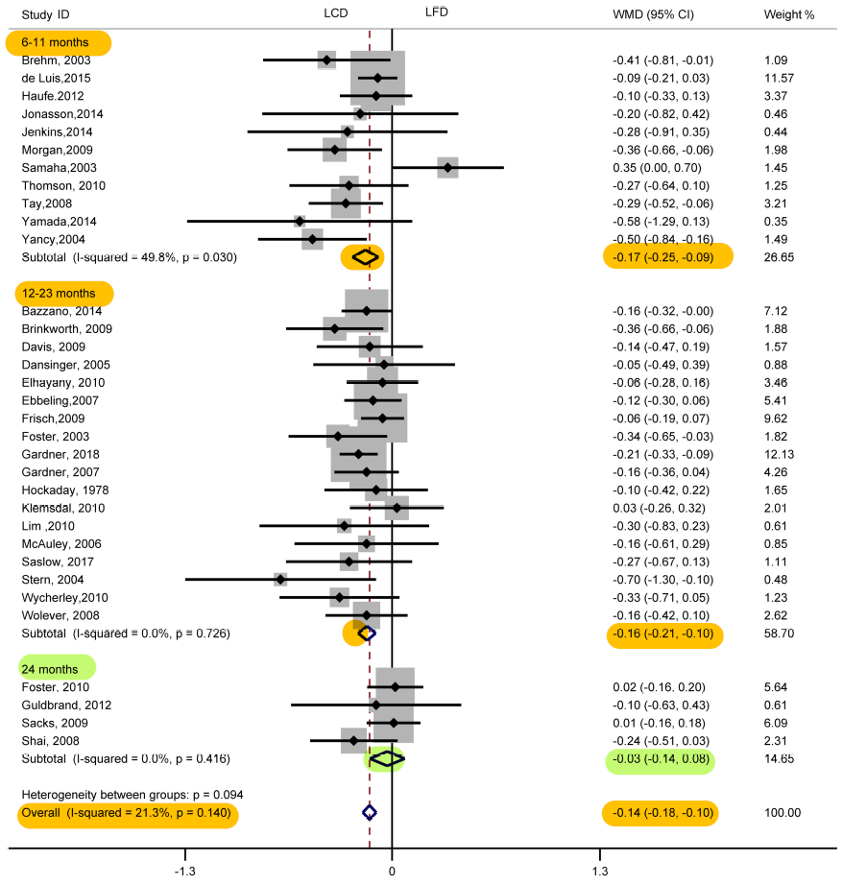
Low-carb vs Low-fat diets: blood lipids
Long-term
LDL increase
6-11 months
+0.12 (0.04 to 0.21)
12-23 months
+0.11 (0.06 to 0.17)
24 months
+0.05 (-0.05 to 0.14)
Overall
+0.10 (0.06 to 0.14)
Triglyceride reduction
6-11 months
-0.17 (-0.25 to -0.09)
12-23 months
-0.16 (-0.21 to -0.10)
24 months
-0.03 (-0.14 to 0.08)
Overall
-0.14 (-0.18 to -0.10)
(Lei et al, Front Nutr 2022)
Notes:
This study also assessed additional parameters. As expected, LCDs increased LDL cholesterol levels by 0.10 mg/dL, while triglyceride levels decreased by -0.14 mg/dL. When examining the effects by time category, significant results were maintained up to 24 months, with no significant difference observed beyond that period, consistent with the changes observed in body weight.

Slide 12
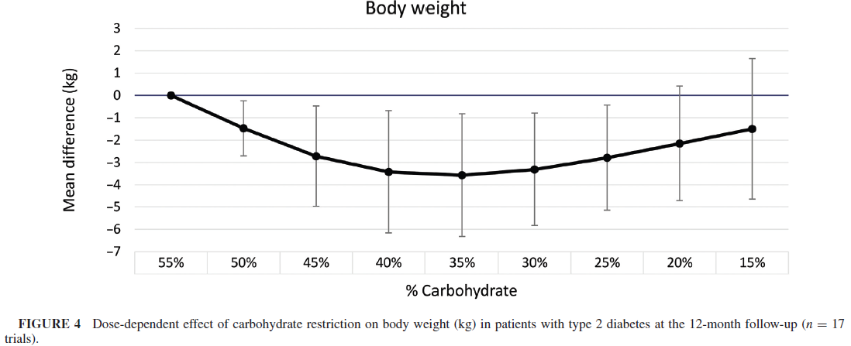
Low-carb diets: dose-response relationship
Meta-analysis
Period: up to May 2021
Studies: 50 RCTs with ≥ 4 weeks, 4291 patients with type 2 diabetes
Definition
Carb-restricted diets: carb ≤ 45%
Control: carb 55-65%
6 months (35 trials)
12 months (17 trials)
U shaped effects were seen for total cholesterol and LDL cholesterol as well as body weight between carb intake from 10% and 65%.
(Jayedi et al, Am J Clin Nutr 2022)
Notes:
This slide presents another meta-analysis that focused on dose-response relationships in low-carb diets. This meta-analysis included 50 RCT lasting more than 4 weeks, specially targeting adult with type 2 diabetes.
In this meta-analysis, low-carb diets was defined as less than 45%, while control diets consisted of 55 to 65% of energy from carb. The study identified a linear association between carb intake ranging from 10 to 65% and body weight reduction. However, for trials lasting 12 months trials, a U-shaped relationship emerged, indicating that the highest reduction in body weight occurred at a carbohydrate intakes of 35 to 40%.
Additionally, this studies examined various parameters and found that HbA1C and fasting blood glucose levels displayed a linear trend corresponding to carb intake from 10% to 65%. In contrast, total cholesterol and LDL levels followed a U-shaped pattern, similar to body weight reduction.

Slide 13
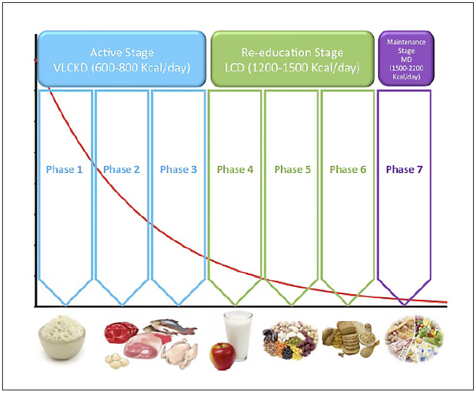
Very Low-Calorie Ketogenic diet (KLCKD)
Very Low-Calorie Ketogenic Diet
Energy: 500-800 kcal/day
Carb: low content (<50g/day)
(≒13% of energy)
Protein: 1-1.5g/kg IBW
(~43%)
Fat: 15-30g
(~44%)
15 studies, adults with BMI 30~50, mainly RCT, conducted in Italy or Spain
Notes:
What is the evidence for ketogenic diet, which are classified as very low-carb diets?
According to the European guideline on obesity management, a structured dietary regimen is recommended based on a meta-analysis that begins with a very low-carb phase and progressed to a low-carb phased with increasing energy intake.
In the first active stage, carb intake is limited to less than 50 g/day, representing approximately 13% of energy with an overall caloric intake of 500 to 800 kcal. The second stage, known as the re-education stage, gradually reintroduces carb while increasing energy intake between 1200 to 1500 kcal/day. Finally, the third stage is the maintenance stage, which aims to establish an individualized dietary pattern with energy intake ranging from 1500 to 2000 kcal.
** dietary regimen
1) VLCKD (8-12 weeks): Carb <50g from veg (low GI food), Fat 10g of olive oil, Protein 0.8-1.2g/kg IBW**
2) Reeducation, LCD: Carb gradually reintroduced (fruit & dairy→legumes→ high GI foods)
3) Maintenance: Individualized

Slide 14
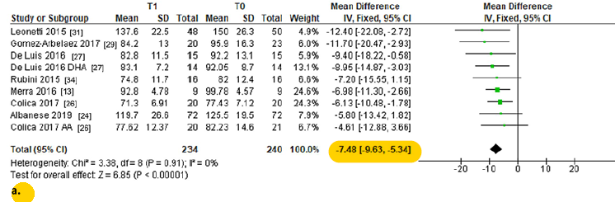
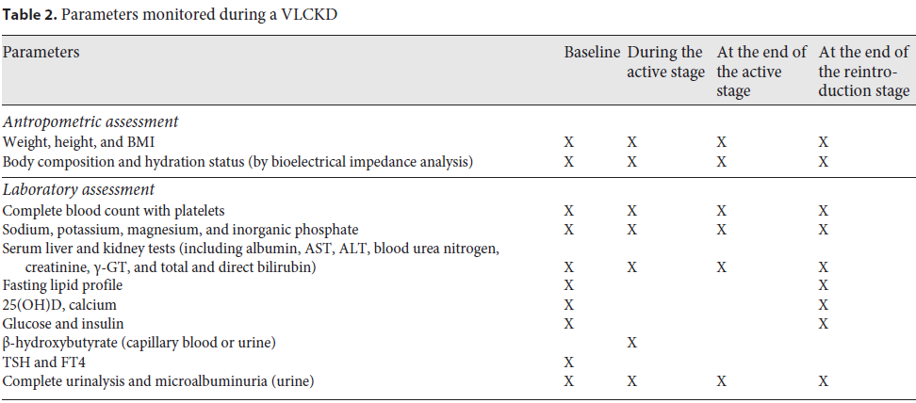
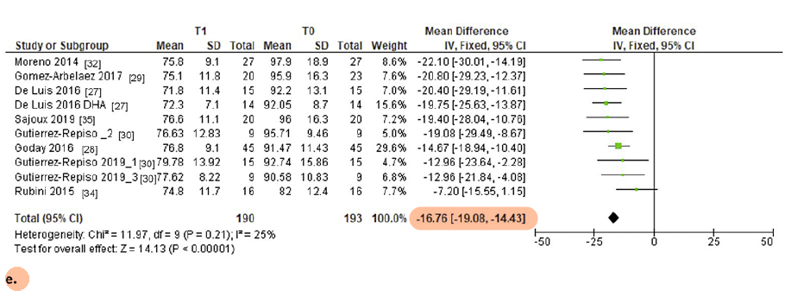
Very Low-Calorie Ketogenic diet (VLCKD)
Side effects
Dehydration-related disorders
Transient hypoglycemia
Gastrointestinal side effects
Hyperuricemia
VLCKD can be recommended as an effective dietary treatment for individuals with obesity under the supervision of a health professional.
Notes:
This guideline presented the results of meta-analysis on VLCKD. As shown in the figure, weight loss after 1 month on VLCKD was -7.48 kg in the top (highlighted as yellow), while weight loss after 4 to 6 months was -16.76 kg in the bottom (highlighted as pink). Although the effects of VLCKD are substantial, potential side effects such as dehydration or etc, shown in Table 2 must be considered. Therefore, VLCKD can be recommended as an effective dietary treatment for individuals with obesity, but only under the supervision of a health professional.

Slide 15
How about Korean diets?
Notes:
Let’s move to the dietary carb intake in Korea

Slide 16
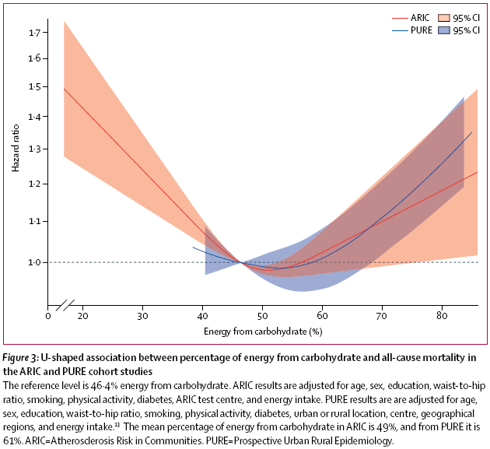
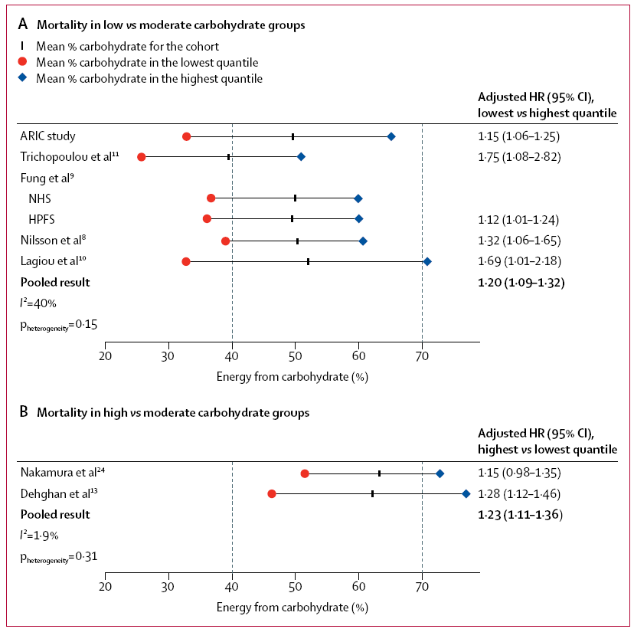
Different range: carbohydrate intake
Low vs Moderate for Western population
Lowest
1.20
Moderate vs High
(Asian population)
Highest
1.23
(Seidelmann et al, Lancet Pub Health 2018)
Notes:
Before we dive into carb intake in Korea, let’s consider the optimal level of carb intake. A landmark study presented a comprehensive view on the association between carb intake and all-cause mortality, combining data from the PURE study, multinational studies, and The ARIC US cohort study.
The figure on the right presents the U-shaped relationship between carb intake and mortality. In the top graph of right figure, compared to moderate carb intake, low-carb intake (common in Western populations) was associated with a 20% increased risk of mortality. On the bottom graph, high carb intake also showed a 20% increased risk.
In my research, which focuses on populations with a carb intake range of 40% to 80%, I emphasize the need to reduce excessive carb intake. However, this doesn’t mean cutting carbs below 45%, but rather reducing it to around 50%.
This study provides valuable insights into the U-shaped relationship between carb intake and health outcomes, suggesting an optimal range around 50%, offering a holistic perspective on the full range of carbohydrate intake.

Slide 17
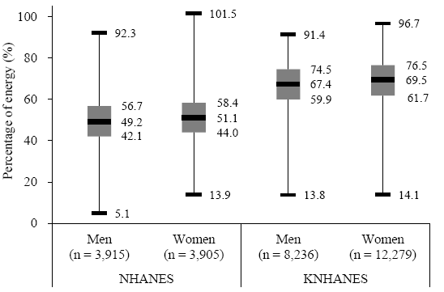
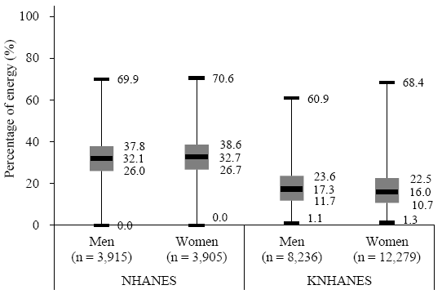
Macronutrient in US v Korea
Carbohydrate for Koreans (55-65%)
Fat for Koreans (15-30%)
Figure 1. Distribution of carbohydrate intake among participants in the NHANES and KNHANES 2007-2012
Figure 2. Distribution of fat intake among participants in the NHANES and KNHANES 2007-2012
(Ha et al, Eur J Clin Nutr 2018)
Notes:
This slide present one of my research work comparing carb intake between the US and Korea.
The carb intake data is shown as a box-plot, which illustrates the distribution from the 25th to the 75th percentile for each population. For example, men in the US consume carb ranging from 42.1% to 56.7%, while men in Korea have a much higher intake, ranging from 59.9% to 74.5%. The red box indicates the recommended carb intake range of 55 to 65%, set by the Korean Nutrition Society; however, only a small proportion of the population meet these recommendations.
Additionally, the high carb intake in Korea is accompanied by a lower fat intake, with the average fat intake around 16% or 17%, which aligns with the recommended fat intake criteria for most of the population.

Slide 18
Carb & fat intake with dyslipidemia
Data from the Korean National Health And Nutrition Examination Survey 2008-2012
High carb intake (Q5 vs Q1)
High fat intake (Q5 vs Q1)
(%)
(%)
Definition
Elevated Total-C (≥200 mg/dl)
Elevated LDL-C (≥130 mg/dl)
Elevated TG (≥150 md/dl)
Reduced HDL-C (<40 mg/dl)
(Song et al, J Clin Lipidology 2017)
Notes:
This slide presents another my research work, which utilized data from Korean national survey to examine the association of dietary carb and fat intake with dyslipidemia. The findings reflected our previous discussion: high carb intake was linked to increased risks of elevated triglyceride and reduced HDL-cholesterol levels, while high fat intake was associated with higher total and LDL-cholesterol levels in both men and women.

Slide 19
Carb intake with Type 2 diabetes
Data from the Korean Genome and Epidemiology Study, 12y follow up, 40-69y
P for trend=0.03
Excessive carbohydrate intake was associated with increased risks of T2DM in Korean men and women
(Ha, Joung & Song, Diabetes Res Clin Pract 2019)
Notes:
This slide presents another of my research studies, which utilized cohort data from a rural area in Korea. I was quite shocked to find that the middle-aged adults in this region followed a heavily rice-oriented diet, leading to extremely high-carb intake. In the highest quartile, men averaged 78.0% of energy, while women averaged 80.4%. The key finding in this study was that excessive carb intake was associated with an increased incidence of type 2 diabetes.

Slide 20
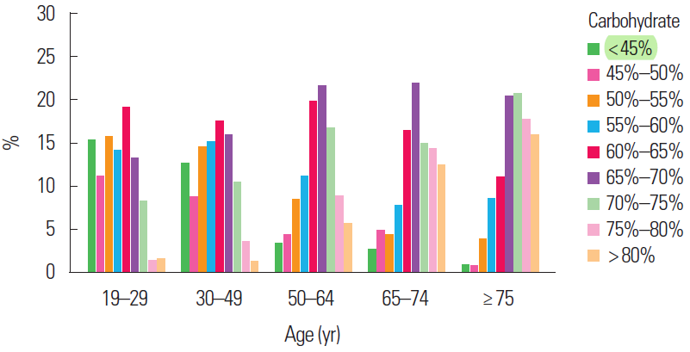
Dietary carb in Korea
(Ha & Song, J Obes Metab Syndr 2021)
Notes:
However, in Korea, LCDs have also gained popularity. A decade age, I used to tell my students to reduce carbohydrate intake. But now, I would say that simply reducing carbs is not the solution.
This is the review article, based on my research, evaluates the trend of carb intake in Korean adults. When high-carb diets are defined as more than 70% of energy, have decreased dramatically from 41.4% in 2010 to 25.1% in 2019.
The percentage of high-carb diets also varies across age groups. Notably, while the lowest proportion of high-carb diets is found in those aged 19 to 29, this group also shows the highest proportion of low-carb diets, defined as less than 45%.

Slide 21
Beyond low-carb diets: Healthy low-carb diets
Notes:
Let’s move to the next phase: what lies beyond low-carb diets?

Slide 22
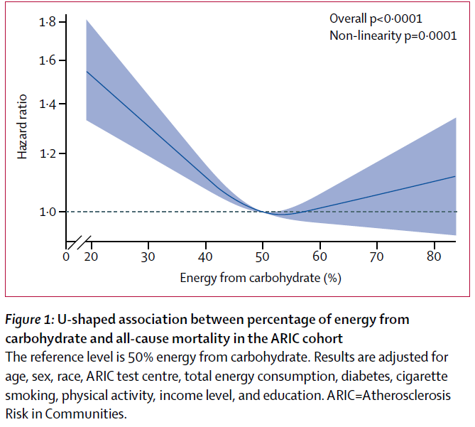
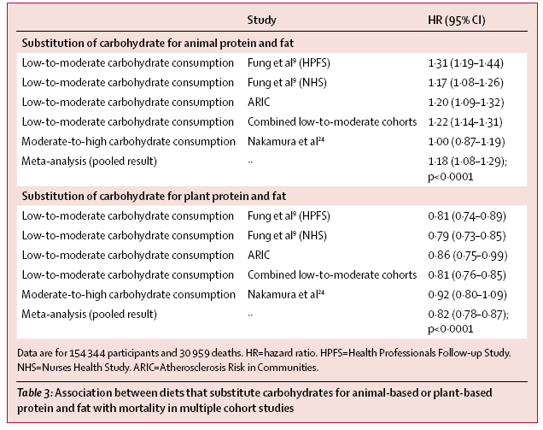
Replace carbohydrate with ??
(Very) low carb diets (<45%) vs Moderate (45~55%)
Animal protein & fat v Plant protein and fat
18%
18%
(Seidelmann et al, Lancet Pub Health 2018)
Notes:
According to the article previously mentioned, which showed a U-shaped association between carbohydrate intake and mortality, the study also analyzed the effects of substituting carbohydrates with other macronutrients. The key finding was that replacing carbs with animal protein and fat increased the hazard risk by 18%, whereas substituting with plant-based protein and fat decreased the risk by 18%.

Slide 23
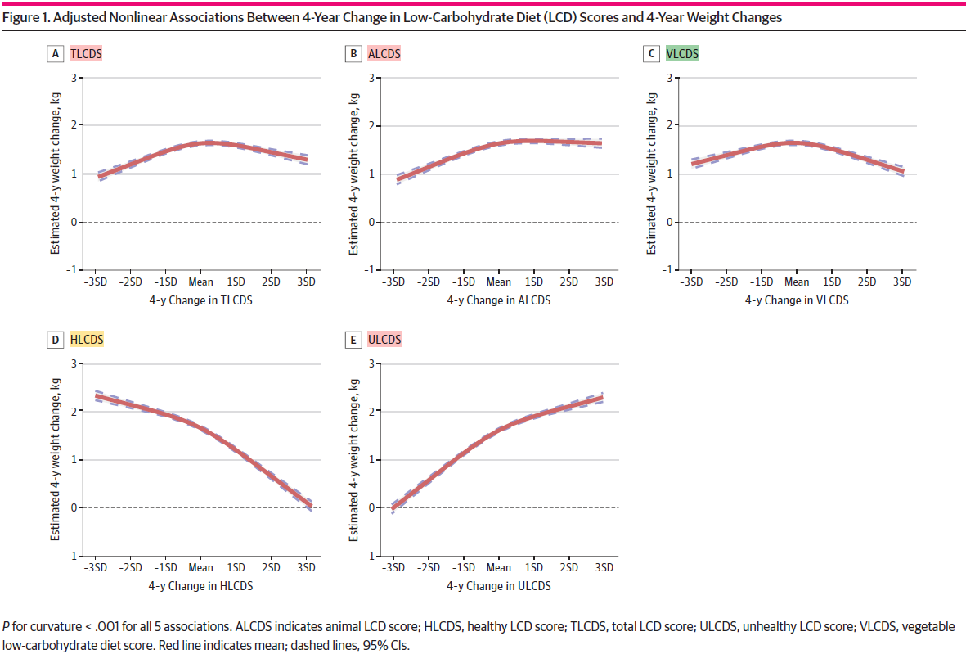
Low-carb diet and long-term weight change by food source
Data from Cohort study (n=123,332)
Nurses’ Health Study I, II
Health Professionals Follow-up study
Outcomes
Weight change over 4-year period
Dietary indices
Total LCD scores (TLCD)
Animal-based LCD (ALCD)
Vegetable-based LCD (VLCD)
Healthy LCD (HLCD)
Unhealthy LCD (ULCD)
Total LCD
Animal LCD
Vegetable LCD
Healthy LCD
Unhealthy LCD
emphasizing less refined carbohydrates, more plant protein, and healthy fat
emphasizing less healthful carbohydrates, more animal protein, and unhealthy fat
(Liu et al, JAMA Netw open 2023)
Notes:
This slide presents a study evaluating the effect of low-carb diets on 4-year weight changes based on the sources of protein and fat. Five scoring system were developed; total, animal-based, vegetable-based, healthy, unhealthy.
The results showed that while total carb intake and the source of protein (animal or vegetable) had similar effects, a healthy low-carb diet was associated with weight reduction, whereas an unhealthy low-carb diet was linked to weight gain.
A healthy LCD focuses on less refined carbohydrates, more plant protein, and healthy fats, while an unhealthy LCD emphasizes more animal protein, unhealthy fats, and less healthful carbs. This study underscores that carb quality is more important than the quantity of carb intake, highlighting the role of diet composition in influencing health outcomes.
* Intervention protocol
(1) a total LCD (TLCD) emphasizing overall lower carbohydrate intake; (2) an animal-based LCD (ALCD) that emphasized animal-sourced protein and fat; (3) a vegetable-based LCD (VLCD) that emphasized plant-sourced protein and fat; (4) a healthy LCD (HLCD) emphasizing less refined carbohydrates, more plant protein, and healthy fat; and (5) an unhealthy LCD (ULCD) emphasizing less healthful carbohydrates, more animal protein, and unhealthy fat.

Slide 24
Healthy low-carb diets
DIETFITS study
RCT, 12 months
N=609 (40 y, BMI 33)
Intervention
Healthy low-fat (HLF)
Healthy low-carb (HLC)
Outcomes
12-month weight change
Healthy low-fat/carb diet
20 g/d (8 weeks)
+ 5-15 g/d (12 month)
High quality foods
Maximize vegetable
Minimize added sugars, refined flours, and trans fats
Focus on whole foods (minimally processed)
Healthy low-fat/carb diet
(carb: protein : fat )
Low fat = 48.4 : 20.6 : 28.7 %
Low carb=29.8: 22.9: 44.6 %
There was no significant difference in weight change between a healthy low-fat diet vs a healthy low-carbohydrate diet
(Gardner et al, JAMA 2018)
Notes:
This is a well-designed randomized controlled trial (RCT), comparing healthy low-fat versus low-carb diets, with both approaches emphasizing high-quality foods. The key finding, as highlighted in yellow in Table 3, was that both diets resulted in similar weight reduction. However, BMI, HDL, and triglycerides improved more significantly in the healthy low-carb group (highlighted in pink), while LDL was significantly lower in the low-fat group.
This study provides key insights into the importance of carbohydrate quality. The study suggests that core nutritional principles—focusing on high-quality foods—are more important, and the choice between low-fat or low-carb diets can depend on participants' preference.

Slide 25
Moderate carb with plant/animal protein
Using 2013-2017 KNHANES data for 7,965 adults
MCP = carb 50-60% + plant/animal protein ≥1
MCA = carb 50-60% + plant/animal protein <1
HCP = carb ≥70% + plant/animal protein ≥1
HCA = carb ≥70% + plant/animal protein <1
Younger adult group (19-49 years): the stronger association
(Ha et al Nutrition J 2020)
Notes:
This study, another from my research utilizing National Survey data, evaluated moderate carbohydrate intake by food source. Moderate carb diets were defined as 50-60%, while high carb diets were more than 70%. The ratio of plant to animal protein intake was calculated, with a ratio over 1 labeled as a plant-based diet.
The key findings showed that compared to those with moderate-carb, plant-based diets,
those with high-carb, plant-based diets had 1.73 times the odds of metabolic syndrome, and individuals with high-carb, animal-based diets had 2.42 times the odds.
This study also highlights that the impact of moderate carbohydrate diets varies depending on the source of the food, with plant-based sources showing a lower risk of metabolic syndrome compared to animal-based sources.

Slide 26
Summary
No universal definition exists low-carb diets. Generally, they provide < 45% of energy from carbohydrates, with very low-carb diets as < 10%.
Low-carb diets offer short-term benefits for weight loss and improving triglycerides and HDL cholesterol. Long-term, no significant advantage over low-fat diets beyond 12 months.
Traditional Korean diets are high in carbohydrates with low in fat. Shifting toward a low-carb diet poses challenges due to the carb-rich dietary culture.
Healthy Low-Carb diets prioritize carbohydrate quality over quantity, incorporating whole grains, vegetables, and healthy fats.

Slide 27
Thank you for listening

